Slide 1
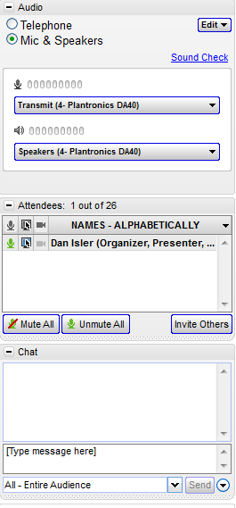
Please Sign in
Hello Attendees,
Please enter the following information in the chat box before the training begins.
Full name
Email address
Account name you are representing
Store name you are representing (for Store Managers)
We appreciate your cooperation and will begin the training shortly.
www.cstoreoffice.com

Slide 2
C-STORE OFFICE
ADVANCED ACCOUNTING – CSO Transaction Assignments
www.cstoreoffice.com

Slide 3
Introduction
Welcome to C-Store Office
Who am I?
My name is Anthony Colpo and I am a Financial Analyst
www.cstoreoffice.com

Slide 4
Agenda
Data Types
Debit Entry
Credit Entry
Chart of Accounts
Data Converter Tool
www.cstoreoffice.com

Slide 5
What are Transaction Assignments?
Transaction Assignments are the data mapping in CSO
Data is mapped based on the type and given a specific Debit and Credit General Ledger Account
The Transaction Assignments are the basis of how things get into your General Ledger
The CSO Clearing account should have a Zero Balance every shift, on every day
www.cstoreoffice.com

Slide 6
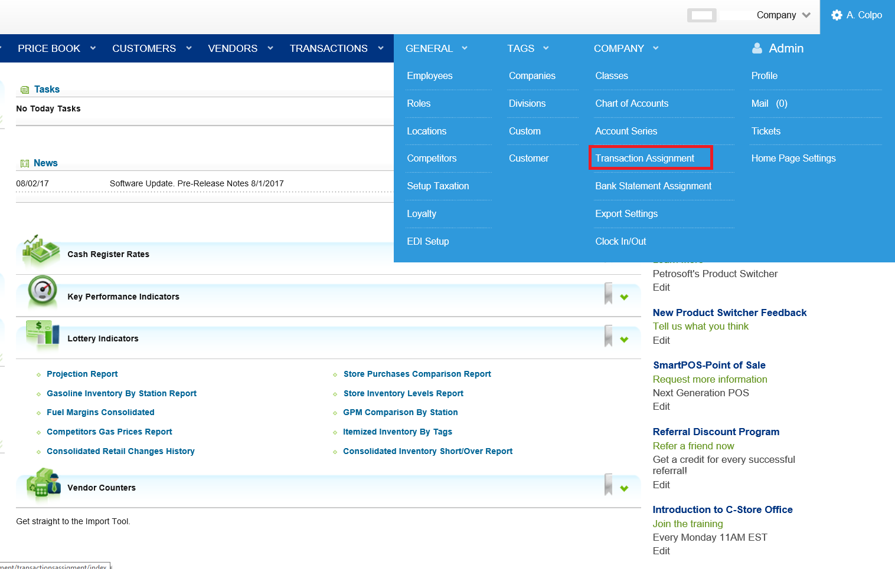
What are Transaction Assignments?
www.cstoreoffice.com

Slide 7
What are Transaction Assignments?
www.cstoreoffice.com

Slide 8
Steps to Assign a Transaction
Add the datatype
Choose Debit
Choose Credit
www.cstoreoffice.com

Slide 9
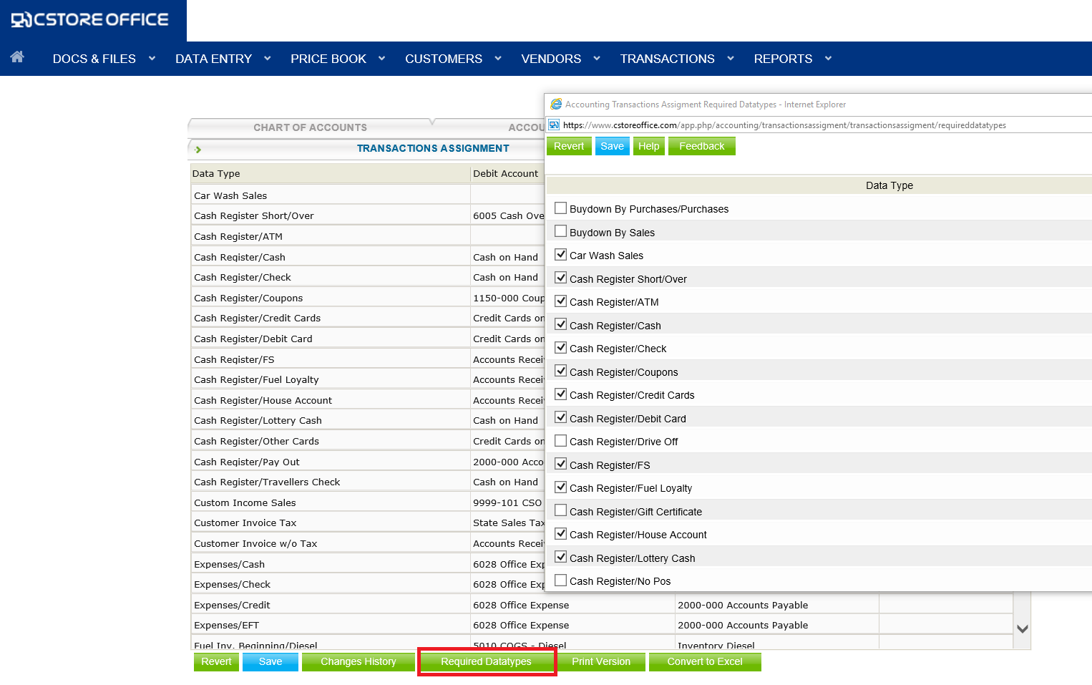

Slide 11
Choosing the Debit and Credit accounts
Select the account that you want to debit
Select the account that you want to credit
Click “Enter” button on that line item
When finished, click “Save” button
www.cstoreoffice.com

Slide 12
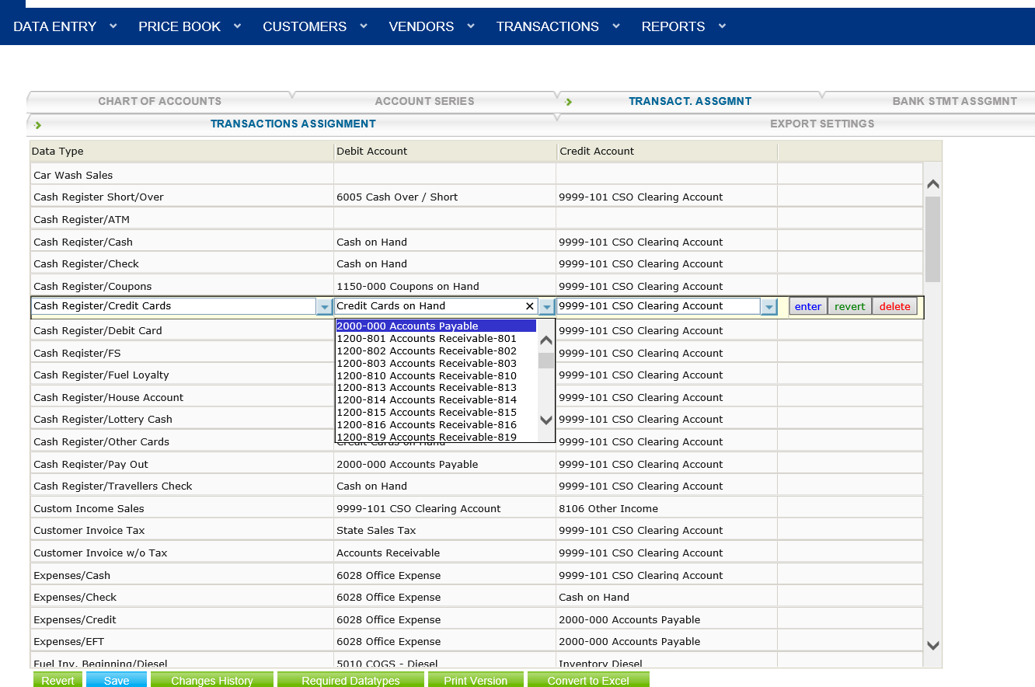

Slide 13
Steps to Backdate the Data
Data Type is added, mapped and saved
Go to Account Register>Data Converter Tool
Select date range, location and datatypes
Select Update Data
www.cstoreoffice.com

Slide 14
What is the Data Converter Tool ?
The Data Converter Tool is a way to refresh the data as it moves over into the Accounting Module of CSO.
The Data Converter Tool is a custom interface that identifies the different types of Data and allows the data to move over to accounting, based on the Data Type.
You should now run the Data Converter Tool for the newly added Data Type. Go to Transactions > Tools > Data Converter. Select the date and new Data Type, Class and the UPDATE DATA button
www.cstoreoffice.com

Slide 15
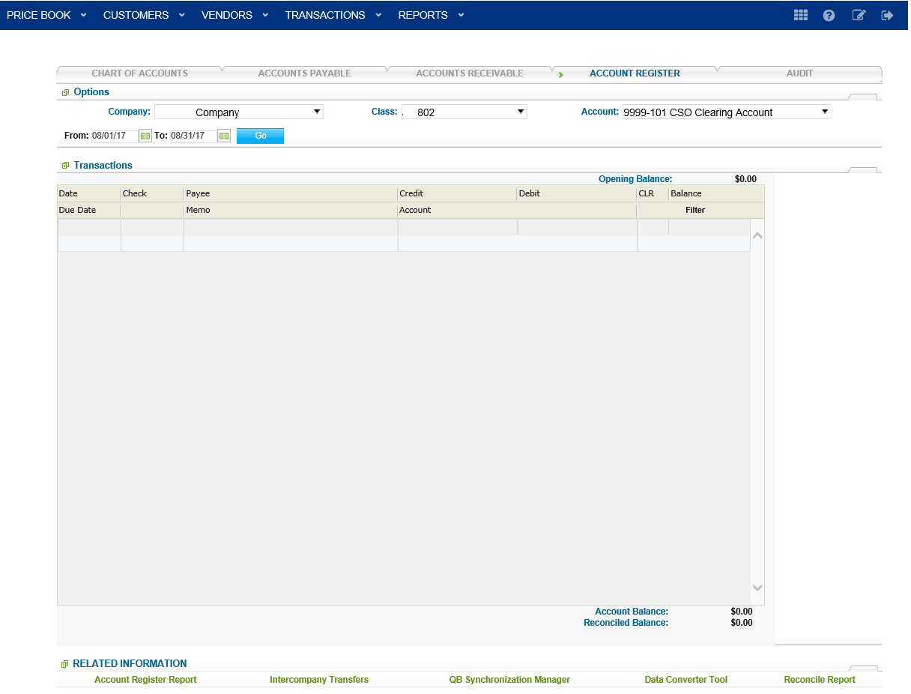

Slide 16
Run the Data Converter Tool
Go back to the Account Register screen (under Transactions)
On the Lower right side, click “Data Converter Tool”
A new window opens with the DCT
Choose date range
Select datatypes to update
Scroll down and click update
Do not click “Delete Data”
www.cstoreoffice.com

Slide 17
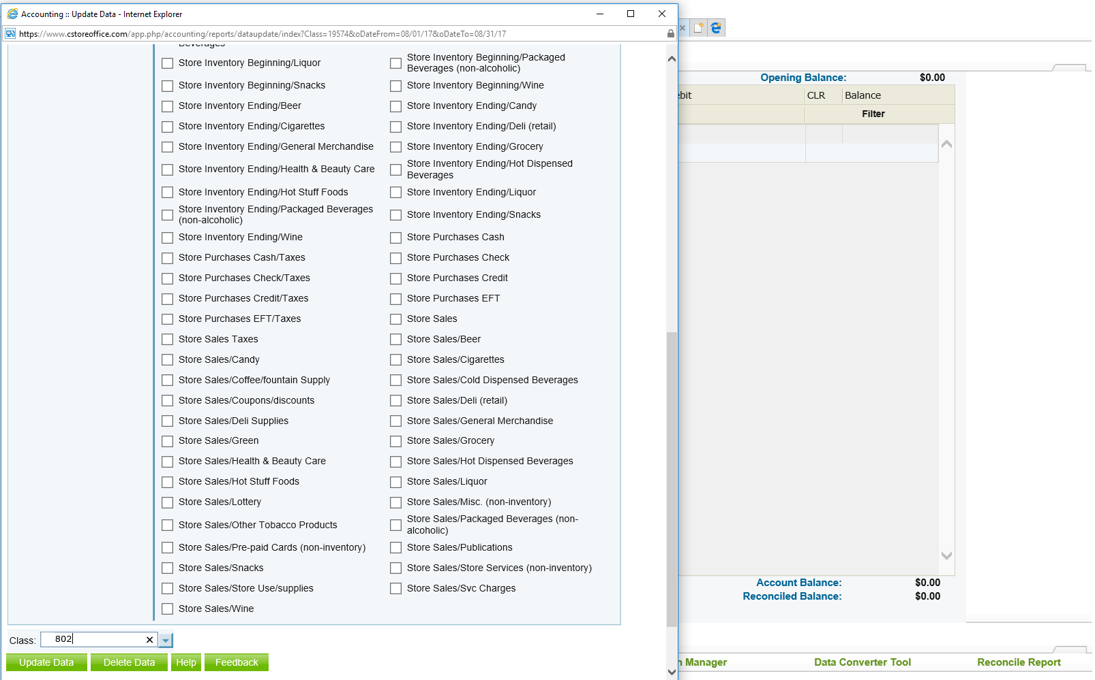
www.cstoreoffice.com

Slide 18
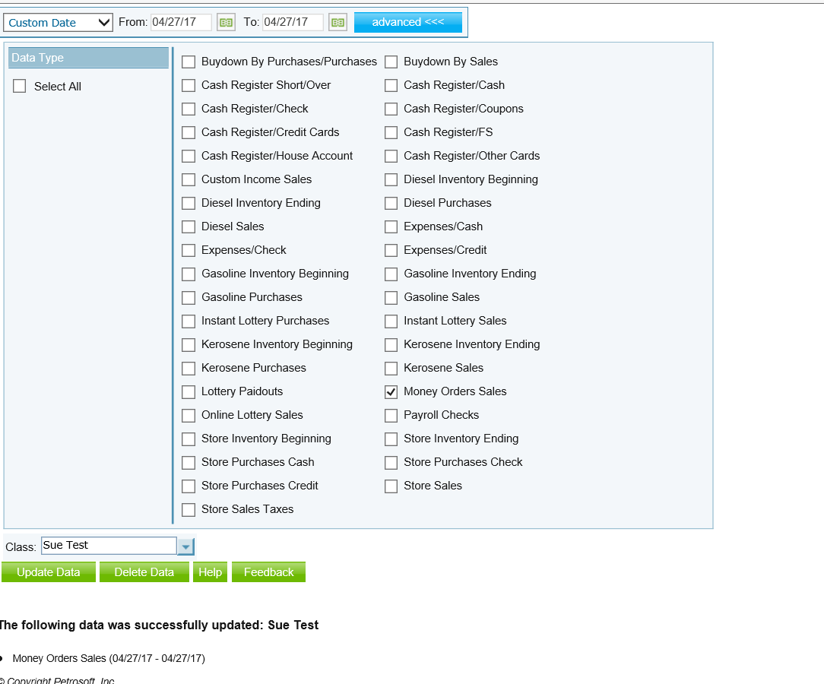

Slide 19
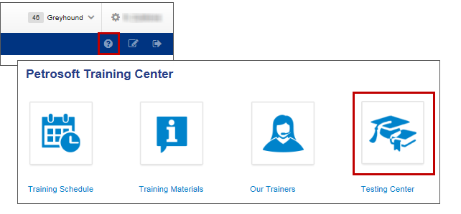
Training Center
For additional testing on what you have learned, please refer to our new “Testing Center”.
To access this new feature, click the help icon, and then select Testing Center.
www.cstoreoffice.com

Slide 20
THANK YOU FOR YOUR TIME!
Get in Touch
Petrosoft LLC
290 Bilmar Drive
Pittsburgh, PA 15205
1.412.306.0640
www.cstoreoffice.com

